Slide 1
Problem 1
Consider a vertical wall of height H in contact with an isothermal fluid reservoir. For the purpose of scale analysis, select the square flow region of height H and horizontal thickness H. Show that if in the momentum equation you invoke a balance between friction and buoyancy, the inertia/friction ratio comes out to be of order Gr_{H} = (gβ ΔT H³)/ν² (note that the H × H region is not the boundary layer region; hence, the conclusion ‘‘inertia/friction ∼ Gr_{H}’’ does not apply to the boundary layer region). Is the vertical velocity scale derived above compatible with the v scale recommended by the energy equation for the H × H region? In other words, is the invoked balance friction ∼ buoyancy in the H × H region realistic?

Slide 2
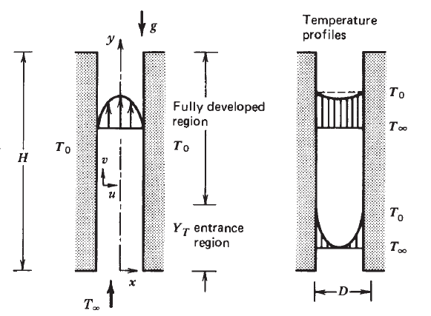
Problem 2
Using natural flows, a solar chimney has to be designed to heat the air to a uniform temperature at a constant mass flow rate. The chimney is planned to design using two parallel walls with the width of the wall significantly higher than the height of the chimney. Design the chimney by looking into the H/D. what is the condition for which the designed chimney will work and will be able to discharge fluid at a constant rate? Assume any necessary conditions with proper justification.
Hint: Find the average heat flux between the two parallel walls facing each other as depicted in the figure.
Assume the necessary conditions for an analytical solution to the problem. Validate your assumptions with the necessary condition

Slide 3
Problem 3
You have a bottle of cold drink at room temperature, and you would like to drink it cold as soon as possible. You place the bottle in the refrigerator; however, you have the option of positioning the bottle (1) vertically or (2) horizontally. The refrigerator cools by natural convection (it does not employ forced circulation).
(a) Which way should you position the bottle? Describe the goodness of your decision by calculating the ratio t₁/t₂, where t represents the order of magnitude of the time needed for the bottle to reach thermal equilibrium with the refrigeration chamber (base this calculation on scale analysis).

Slide 4
Data :
; both have same unit
k_{air}=0.025 and k_{cd}=0.58; both have same unit
Subscript cd stands for cold drink
For high Pr number fluids (e.g. air, water etc.) the Nu scales as
For heat transfer from vertical walls
Where, Ra_{H} is the Rayleigh number
Where H is the height of the wall
For heat transfer from horizontal walls
Where L is the characteristic length
Consider H=5L and assume
Where T_{s} is the surface temperature of the bottle

Slide 5
Assumptions: (1) The bottle is cooled only by natural convection (2) No spatial variation of temperature, the temperature of the surface of the bottle (T_{s}) and cold drink (T_{cd}) and (T_{air}) will remain uniform everywhere and will only change with time (3) The cold drink does not contain any bubble or even if it contain bubbles those will have no effect in heat transfer (4) The time of cooling will be approximated by taking an order of magnitude of the time needed for heat transfer (5)
Find: Whether to place the bottle vertically or horizontally for faster cooling

Slide 6
Solution:
The rate of cooling down of the bottle (Q) will be (assuming no spatial variation of temperature and the cold drink temperature will be uniform and T_{cd} at any time instant),
…….(1)
where c is the specific heat
Now this heat is dissipated in the air
So,
…….(2)
where A is the total bottle area.

Slide 7
Equating both the equations we will get
…….(3)
So, the order of cooling down time for the cold dink bottle will be
…….(4)
If we the above equation carefully only h (heat transfer coefficient) will be a function of the orientation of the bottle. Rest parameters are independent of the orientation.

Slide 8



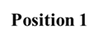
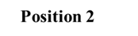
Q
h=h₁
air
h_{cd}
h=h₂
h_{air}
h_{cd}
h_{air}
cd
Q
air
cd
So, we can write
Subscript 1 and 2 stands for vertical and horizontal position respectively
…….(5)

Slide 9
Now we have to estimate the overall heat transfer coefficient (h) for the horizontal and vertical position of the cold drink bottle respectively.
The overall heat transfer coefficient (h) for this problem will be
…….(6)
Position 1
From the scale analysis for Pr >1 fluids we can write
…….(7)

Slide 10
If we assume the same
inside and outside the bottle,
Then we can write
Since, h_{cd} >> h_{air} we can say the overall h is
…….(8)

Slide 11
Similarly,
Position 2
From equation (5) we can write
So, the cooling the cold drink bottle by placing it vertically will take 50% more time compare to the horizontal position. So, if you want to have the cold drink as soon as possible place it horizontally

Slide 12
Problem 4
The ABC Evening News Report in a news segment on hypothermia research studies at the University of Minnesota claimed that heat loss from the body (at 25°C ) is faster in 10°C water than in air at the same temperature. Is that a realistic statement? If the statement is found to be true then how fast? Person can be approximated as a vertical cylinder of diameter D = 0.3 m and length L = 1.8 m
The variation of Ra with the Nu is given as
Where,
Data:
For air,
k = 0.0293 W/m⋅K,
ν = 19.91 × 10⁻⁶ m²/s,
α = 28.4 × 10⁻⁶ m²/s;
β_{a} = 3.45×10⁻³ K ⁻¹
For water,
k = 0.598 W/m⋅K,
ν = 1.081 × 10⁻⁶ m²/s,
α = 1.431 × 10⁻⁷ m²/s,
β_{w} = 174 ×10⁻⁶ K ⁻¹ .

Slide 13
Solution:
Known: Person, approximated as a cylinder, experiencing heat loss in water or air at 10°C.
Find: Whether heat loss from body in water is faster then that in air. If so then how fast?
Assumptions: (1) Person can be approximated as a vertical cylinder of diameter D = 0.3 m and height H = 1.8 m (2) Initially the outer surface of the body is kept at 25°C
(3) Loss is only from the lateral surface of the body.
Analysis: In both water (w) and air (a), the heat loss from the lateral surface of the cylinder approximating the body is
…….(9)

Slide 14
here T_{s} and T∞ are the same for both situations. Hence,
…….(10)
For Vertical cylinder in air:

Slide 15
So, from the relation with Nu
⇒
Vertical cylinder in water:

Slide 16
So, from the relation with Nu
⇒
Hence, from this analysis we find (substituting in equation 10 )
⇒
Conclusion:
Heat loss from the body is 117 times faster in 10°C water than in air at the same temperature.

Slide 17
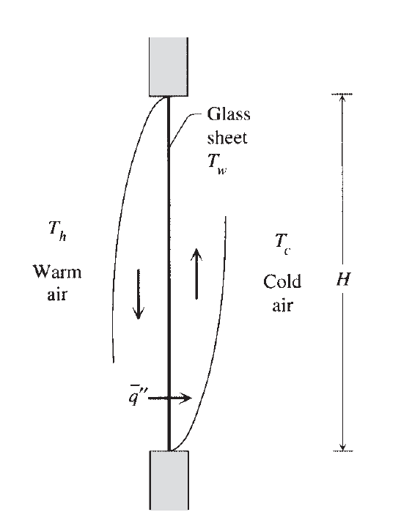
Problem 5
The single-pane window problem consists of estimating the heat transfer rate through the vertical glass layer shown in Fig. The window separates two air reservoirs of temperatures T_{h} and T_{c}. Assuming constant properties, laminar boundary layers on both sides of the glass, and a uniform glass temperature T_{w}. Find the relationship between the average heat flux qʺ with T_{h} to T_{c} . Expression for the Nu is given as

Slide 18
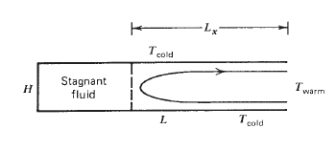
Problem 6
Machined into a solid wall of temperature T is a slender two-dimensional cavity of height H and length L (H<< L). The cavity communicates laterally with an infinitely large fluid reservoir of temperature T + T. The situation is shown schematically in the Figure. Show that if the cavity is slender enough, the buoyancy-driven flow will penetrate the cavity only to a certain depth whose order of magnitude is
Determine the order of magnitude of the total heat transfer rate between the fluid reservoir and the walls of the cavity.

Slide 19
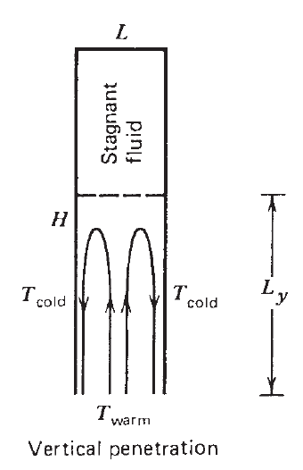
Problem 7
Consider the penetration of natural convection into a vertical slender cavity of height H and gap thickness L (H>>L). As is shown in the Figure, One end of the cavity is closed and the other communicates with a very large fluid reservoir. Rely on scaling arguments to show that when a temperature difference ΔT is established between the fluid reservoir and the walls of the cavity, the flow penetrates vertically to a depth that scales as
Estimate the order of magnitude of the heat transfer rate between the fluid reservoir and the walls of the cavity, assuming that L_{y} < H.

